Slide 1
HW 8
Group 3
Presenter 張君豪

Slide 2
SpreadsheetApplication

Slide 3

Requirements Statement 1
In a spreadsheet application,

Slide 4
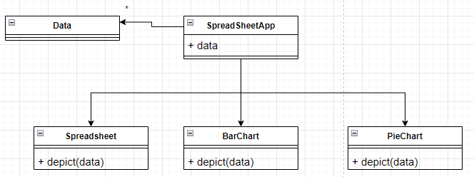
Requirements Statement 2
A spreadsheet object, bar chart object, and pie chart object can depict information in the same application data object by using different presentations.

Slide 5
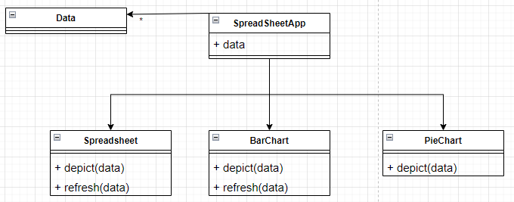
Requirements Statement 3
When the user changes the information in the spreadsheet, the bar chart reflects the changes immediately, and vice versa.

Slide 6
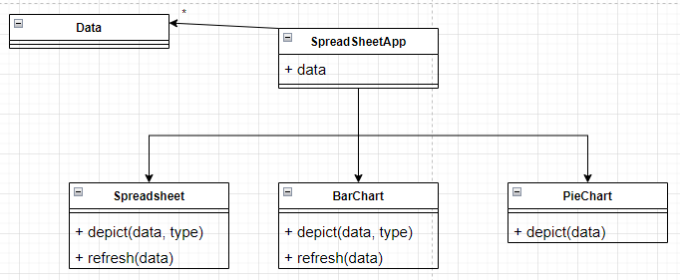
Requirements Statement 4
Both a spreadsheet object and bar chart object can depict inforation in the same application data object by using different presentations

Slide 7
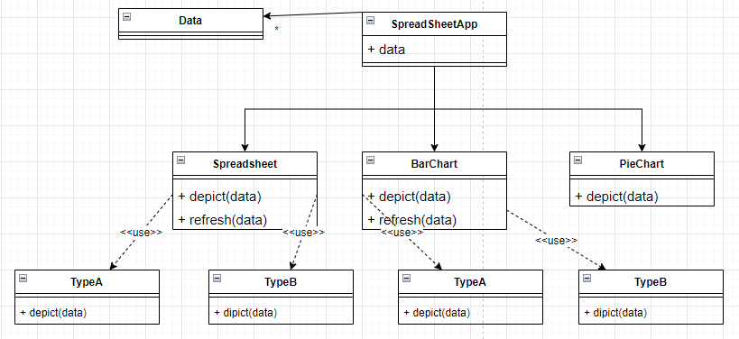
Refactoring - Encapsulation

Slide 8
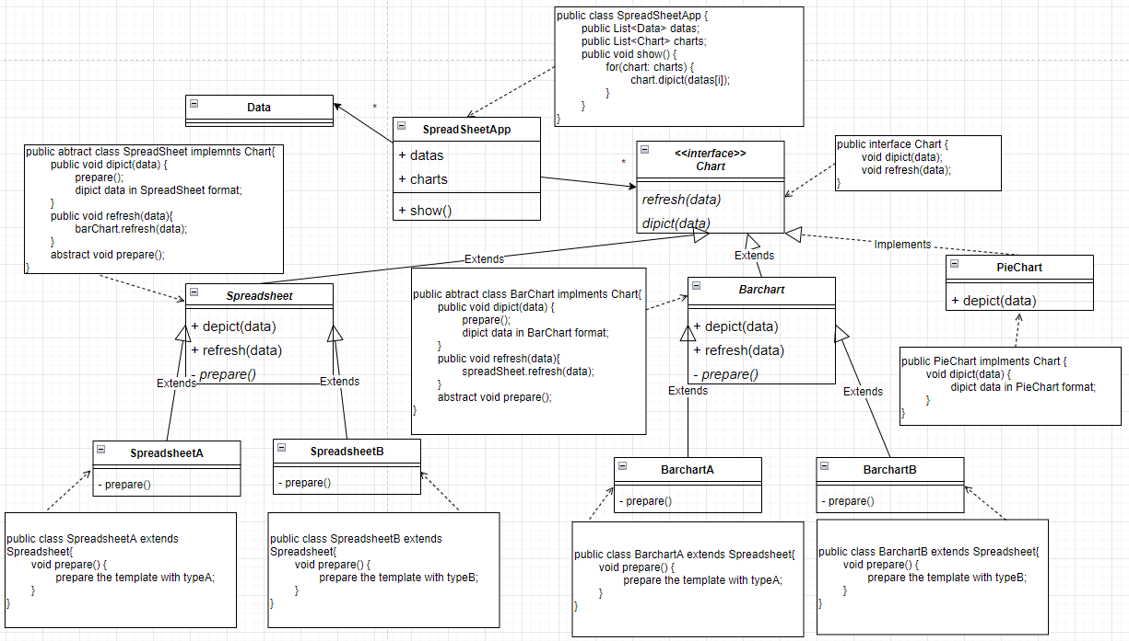
Refactoring - Abstraction

